Slide 1
Parallel Database System
Alexander Lyngdoh
MCA 4th Semester
Roll No: 16

Slide 2
Contents
What is parallel processing?
Different architecture
Types of parallelism
Partitioning of data
Parallel algorithms for DBMS operations

Slide 3
INTRODUCTION
In centralized database:
Data is located in one place (one server)
All DBMS functionalities are done by that server
Enforcing ACID properties of transactions
Concurrency control, recovery mechanisms
Answering queries
In Distributed databases:
Data is stored in multiple places (each is running a DBMS)
New notion of distributed transactions
DBMS functionalities are now distributed over many machines

Slide 4
What is Parallel Processing?
Divide a big problem into many smaller ones to be solved in parallel
Increase bandwidth

Slide 5
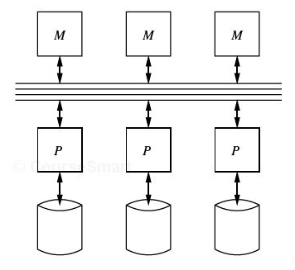
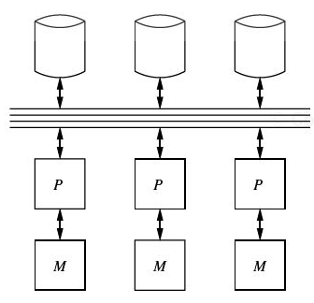
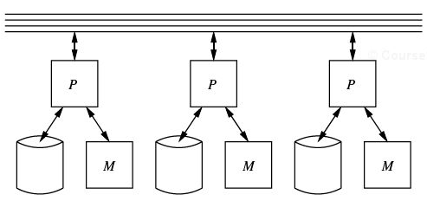
DIFFERENT ARCHITECTURE
Three possible architectures for passing information
Shared-memory
Shared-disk
Shared-nothing

Slide 6
SHARED-MEMORY ARCHITECTURE
Every processor has its own disk
Single memory address-space for all processors
Reading or writing to far memory can be slightly more expensive
• Every processor can have its own local memory and cache as well

Slide 7
SHARED-DISK ARCHITECTURE
Every processor has its own memory (not accessible by others)
All machines can access all disks in the system
Number of disks does not necessarily match the number of processors

Slide 8
SHARED-NOTHING ARCHITECTURE
Most common architecture currently
Every machine has its own memory and disk
Communication is done through high-speed network and switches
Usually machines can have a hierarchy
Machines on same rack
Then racks are connected through high-speed switches

Slide 9
TYPES OF PARALLELISM
Pipeline Parallelism (Inter-operator parallelism)
Ordered (or partially ordered) tasks and different machines are performing different tasks
Partitioned Parallelism (Intra-operator parallelism)
A task divided over all machines to run in parallel

Slide 10
IDEAL SCALABILITY SCENARIO
Speed-Up
More resources means proportionally less time for given amount of data.
Scale-Up
If resources increased in proportion to increase in data size, time is constant

Slide 11
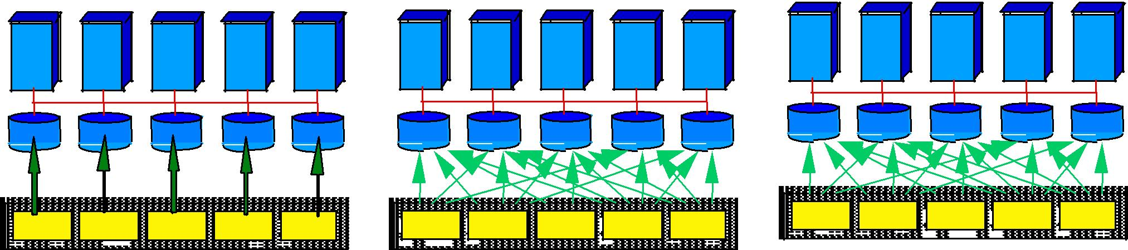
PARTITIONING OF DATA
To partition a relation R over m machines
A..E F.....J K..N O..S T..Z
A..E F.....J K..N O..S T..Z
A..E F.....J K..N O..S T..Z
Range partitioning Hash-based partitioning ^{Round-robin partitioning}

Slide 12
PARALLEL ALGORITHMS FOR DBMS OPERATIONS

Slide 13
PARALLEL SCAN σ_{c}(R)
Relation R is partitioned over m machines
Each partition of R is around |R|/m tuples
Each machine scans its own partition and applies the selection condition c
If data are partitioned using round robin or a hash function (over the entire tuple)
The resulted relation is expected to be well distributed over all nodes
All partitions will be scanned
If data are range partitioned or hash-based partitioned (on the selection column)
The resulted relation can be clustered on few nodes
Few partitions need to be touched
Parallel Projection is also straightforward
All partitions will be touched
Not sensitive to how data is partitioned

Slide 14
PARALLEL DUPLICATE ELIMINATION
If relation is range or hash-based partitioned
Identical tuples are in the same partition
So, eliminate duplicates in each partition independently
If relation is round-robin partitioned
Re-partition the relation using a hash function
So every machine creates m partitions and send the i^{th} partition to machine i
machine i can now perform the duplicate elimination
Same idea applies to Set Operations (Union, Intersect, Except)
But apply the same partitioning to both relations R & S

Slide 15
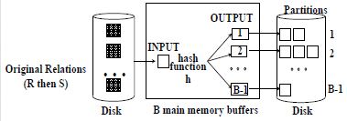
PARALLEL JOIN R(X,Y) ⋈ S(Y,Z)
Re-partition R and S on the join attribute Y (natural join) or (equi join)
Hash-based or range-based partitioning
• Each machine i receives all ith partitions from all machines (from R and S)
Each machine can locally join the partitions it has
Depending on the partitions sizes of R and S, local joins can be hash-based or merge-join

Slide 16
PARALLEL SORTING
Range-based
Re-partition R based on ranges into m partitions
Machine i receives all i^{th} partitions from all machines and sort that partition
The entire R is now sorted
Skewed data is an issue
Apply sampling phase first
Ranges can be of different width
Merge-based
Each node sorts its own data
All nodes start sending their sorted data (one block at a time) to a single machine
This machine applies merge-sort technique as data come

Slide 17
COMPLEX PARALLEL QUERY PLANS
All previous examples are intra-operator parallelism
Complex queries can have inter-operator parallelism
Different machines perform different tasks

Slide 18
PERFORMANCE OF PARALLEL ALGORITHMS
In many cases, parallel algorithms reach their expected lower bound (or close to)
If parallelism degree is m, then the parallel cost is 1(one)/m of the sequential cost
Cost mostly refers to query’s response time

Slide 19
PERFORMANCE OF PARALLEL ALGORITHMS(Contd…)
Total disk I/Os (sum over all machines) of parallel algorithms can be larger than that of sequential counterpart
But we get the benefit of being done in parallel
Example
Merge-sort join (serial case) has I/O cost = 3(B(R) + B(S))
Merge-sort join (parallel case) has total (sum) I/O cost = 5(B(R) + B(S))
Considering the parallelism = 5(B(R) + B(S)) / m

Slide 20
Thank You

